Slide 1

Medical Immunology

Slide 2
Autoimmunity
Immunodeficiency
Viral Hepatitis

Slide 3
Autoimmunity

Slide 4

One of the remarkable properties of the normal immune system is that it can react to variety of microbes but does not react against the individual’s own(self) antigens.
The immune system has to coexist with many commensal microbes that live on the epithelial barriers of their human hosts and the immune system of a pregnant female has to accept the presence of a fetus that expresses antigens derived from the father.
This unresponsiveness to self antigens, called immunologic tolerance

Slide 5
There must exist mechanisms that prevent immune responses to self antigens.
These mechanisms are responsible for one of the cardinal features of the immune system—namely, its ability to discriminate between self and non self (usually microbial) antigens.
If these mechanisms fail, the immune system may attack the individual’s own cells and tissues.
Such reactions are called autoimmunity, and the diseases they cause are called autoimmune diseases.

Slide 6
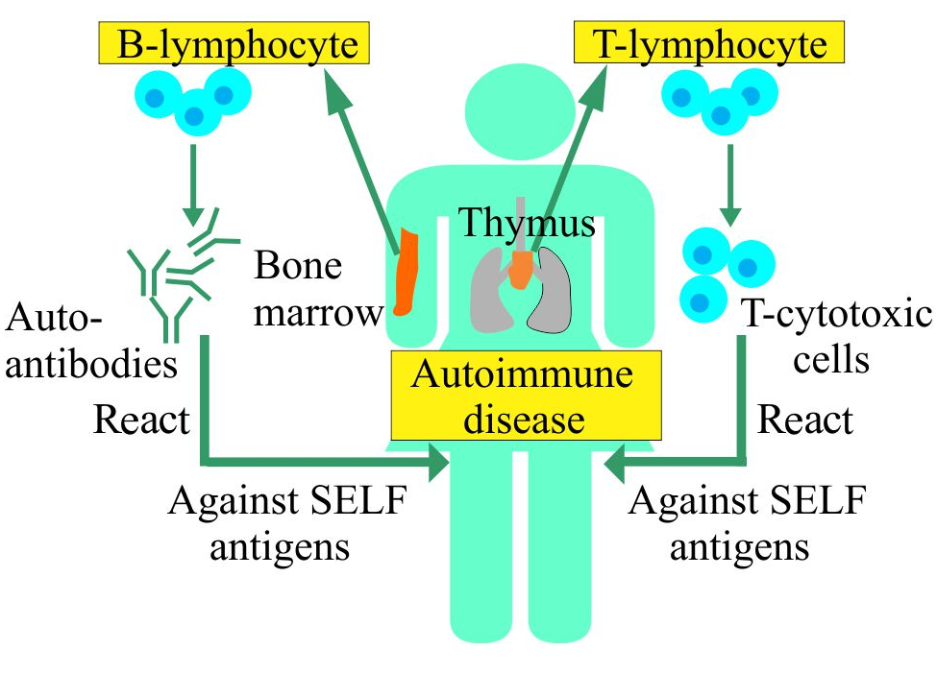
Autoimmunity is defined as an immune response against self antigens.
Tissue injury in autoimmune diseases may be caused by antibodies against self antigens or by T cells reactive with self antigens

Slide 7
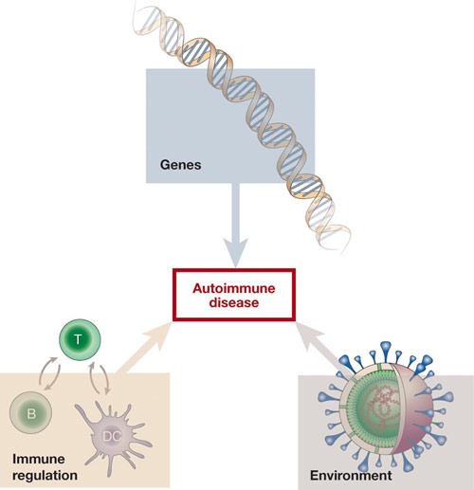
The principal factors in the development of autoimmunity are:
The inheritance of susceptibility genes
environmental triggers, such as infections
Impairment of immune regulation

Slide 8
Types of autoimmune diseases
• Organ-specific:
The immune response is directed toward antigens in a single organ.
Examples:
Addison disease, in which autoantibodies attack the adrenal cortex, and myasthenia gravis, in which they attack neuromuscular cells,
diabetes mellitus type 1 (IDDM) in which the immune system targets insulin-producing beta cells in the pancreas.
Hashimoto's thyroiditis, Graves' disease of the thyroid
• Systemic diseases :
The immune system attacks self antigens in several organs.
Systemic lupus erythematosus, for example, is characterized by inflammation of the skin, joints, and kidneys, among other organs.
Sjogren's syndrome, rheumatoid arthritis (RA).

Slide 9
Diagnosis of autoimmune diseases
No single test can diagnose most Autoimmune diseases.
A combination of tests and an assessment of symptoms to diagnose Autoimmune diseases.
The “Antinuclear Antibody Test” is often the first test that doctors use when symptoms suggest an Autoimmune disease.
A positive test means you likely have one of these diseases, but it won’t confirm exactly which one you have.

Slide 10
Self tolerance
Central tolerance
Thymus and BM
Peripheral tolerance
Peripheral tissues

Slide 11
Immunological tolerance
The ability of the immune system to recognize and differentiate between self and non-self antigens.
Avoiding an immune response against the body's own tissues (self-antigens).
It is a critical mechanism that prevents autoimmune diseases while allowing the immune system to respond to harmful pathogens.

Slide 12
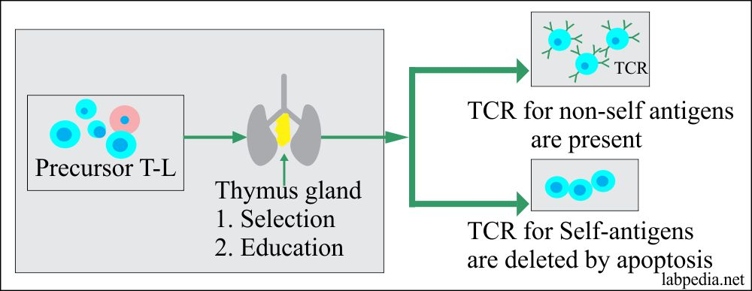
Types of immunological tolerance:
central Tolerance:
  This occurs during the maturation of immune cells in the thymus (for T cells) and bone marrow (for B cells).
  Immature lymphocytes that react strongly against self-antigens are typically eliminated or undergo modifications to become tolerant.
  This process ensure that only immune cells that do not react against self-antigens are allowed to mature and circulate in the body.

Slide 13
2.Peripheral Tolerance:
  This is a set of mechanisms that operate outside the primary lymphoid organs (thymus and bone marrow) to control immune responses.
  Regulatory T cells (Tregs) play a key role in peripheral tolerance by suppressing the activity of other immune cells and preventing them from attacking self-antigens.
  Other mechanisms, such as anergy (functional inactivation) and deletion of self-reactive lymphocytes, contribute to maintaining tolerance in the periphery.

Slide 14
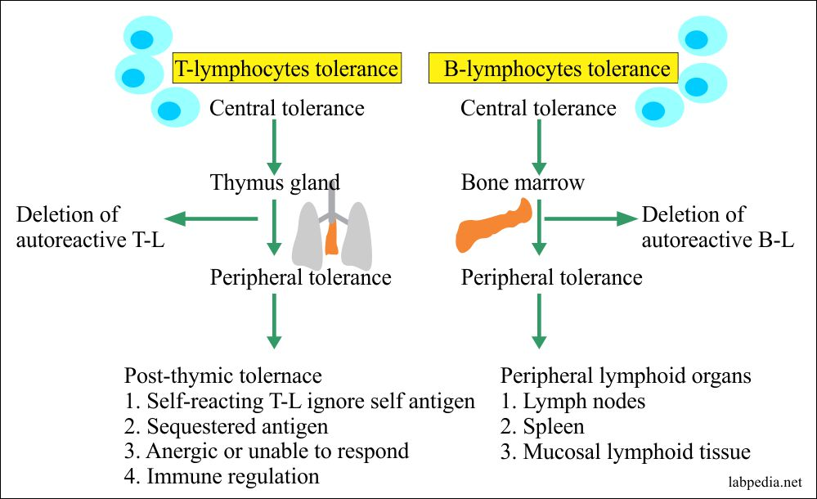

Slide 15
Immunodeficiency

Slide 16
Immunodeficiency Disorders
Immunodeficiency refers to a state where the immune system is impaired, compromising its ability to effectively combat infections.
Immunodeficiency Disorders result from the absence or failure of one or more of the elements of immune system.
This can result from many factors, leading to a spectrum of immunodeficiency disorders.

Slide 17
Classification:
1. Humoral immunodeficiencies (B-cell immunodeficiencies).
2. Cellular immunodeficiencies (T- cell immunodeficiencies).
3. Combined immunodeficiencies.
4. Phagocytic immunodeficiencies.
5. Complement immunodeficiencies.

Slide 18
1. Humoral immunodeficiencies:
a. Selective immunoglobulin deficiency:
There is a deficiency of one or two of the immunoglobulins, while the others are normal e.g.(selective IgA deficiency).
b. Transient hypo gamma globulinaemia of infancy.
2. Cellular immunodeficiencies:
a- Lymphopenia and decreased T- cell numbers.
b- Decreased T – cell function:
Delayed hypersensitivity reaction.
Decreased Ag specific stimulation and IL2 production.

Slide 19
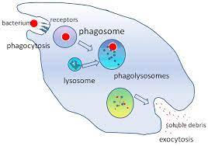
3. Combined immunodeficiencies:
Sever combined immunodeficiency:
There is failure of differentiation of stem cells into T and B cells.
4. Phagocytic immunodeficiencies:
a. Quantitative defect:
Deficiency in the number of phagocytic cell.
b. Qualitative defect (defective function) :
1. Defective chemotaxis.
2. Defective ingestion.
3. Defective intra cellular killing.
5. Complement immunodeficiencies:
There is absence of certain components of the complement system.
This leads to increased incidence of infections.

Slide 20
Types of Immunodeficiency Disorders:
A. Congenital(Primary) Immunodeficiency Disorders:
These are typically genetic or inherited conditions where certain components of the immune system are absent or dysfunctional from birth.
Examples:
severe combined immunodeficiency (SCID)
common variable immunodeficiency (CVID).
B. Acquired(Secondary) Immunodeficiency Disorders:
Acquired later in life due to external factors that weaken the immune system.
Causes include :
diseases (e.g., HIV/AIDS),
medications (e.g., chemotherapy),certain medical treatments.

Slide 21
Human Immunodeficiency Virus (HIV)

Slide 22
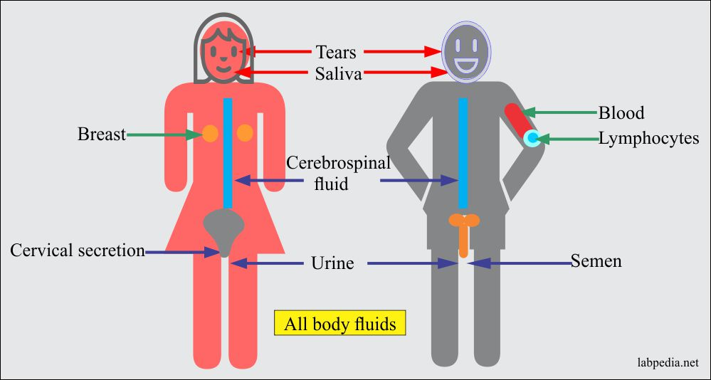
AIDS mode of spread

Slide 23
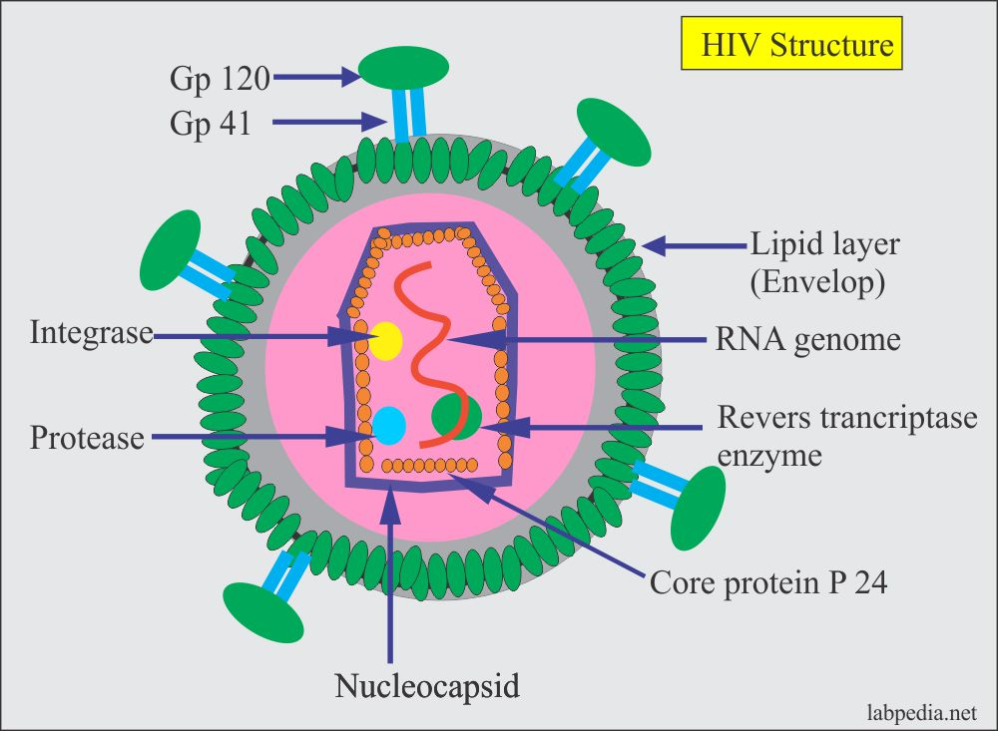
AIDS is caused by the retrovirus HIV, which infects CD4+ T cells, macrophages, and dendritic cells by using an envelope protein (gp120) to bind to CD4 and chemokine receptors and causes progressive destruction of these cells.
The viral RNA is reverse transcribed, and the resulting DNA integrates into the host genome, where it may be activated to produce infectious virus.
Infected cells die during this process of virus replication, and death of cells of the immune system is the principal mechanism by which the virus causes immune deficiency.

Slide 24
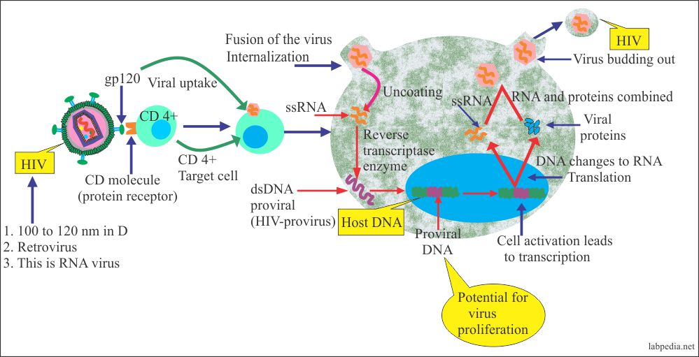
Life cycle of human immune deficiency virus (HIV) cycle
The life cycle of HIV consists of the following sequential steps:
infection of cells,
production of a DNA copy of viral RNA and its integration into the host genome,
expression of viral genes, and production of viral particles

Slide 25
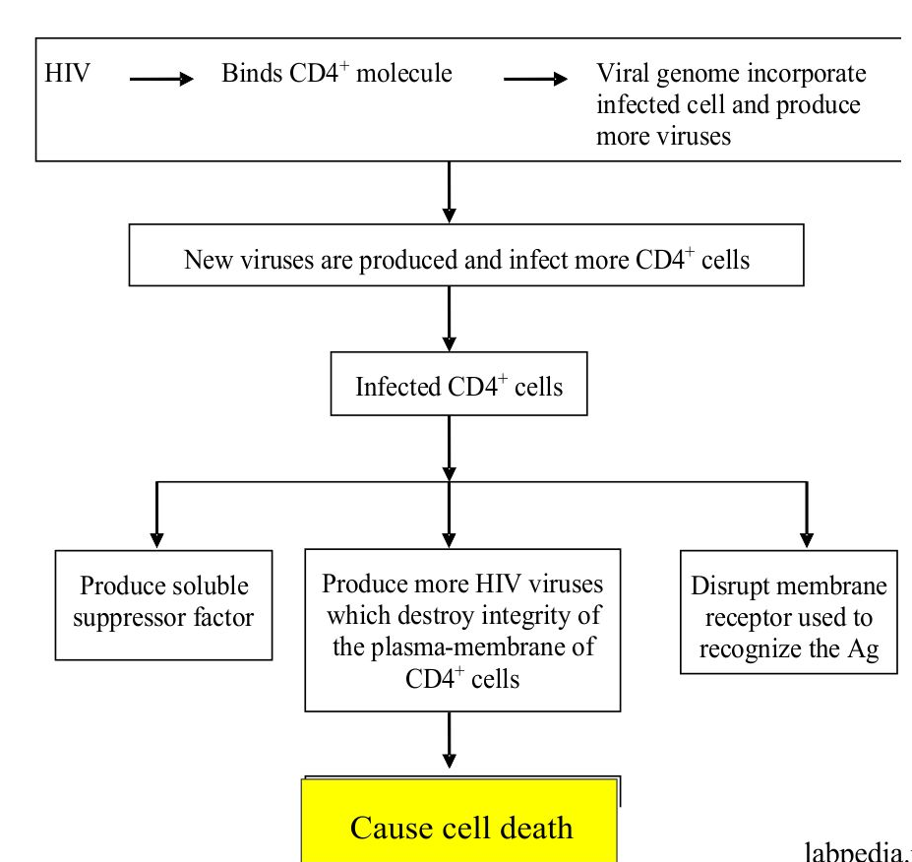

Slide 26
Pathogenesis of AIDS (Acquired Immune Deficiency Syndrome)
AIDS develops over many years as latent HIV becomes activated and destroys cells of the immune system.
Virus production leads to death of infected cells, as well as to death of uninfected lymphocytes, subsequent immune deficiencies, and clinical AIDS
After infection there may be a brief acute viremia, when the virus is detected in the blood, and the host may respond as in any mild viral infection and present with nonspecific symptoms such as fever, body aches, and malaise.

Slide 27
The virus primarily infects CD4+ T cells at sites of entry through mucosal epithelia, in lymphoid organs such as lymph nodes, and in the circulation.
In mucosal tissues at the sites of entry, there may be considerable destruction of infected T cells.
The depletion of CD4+ T cells after HIV infection resulting from production of viral particles in infected cells, as well as death of uninfected cells.

Slide 28
Diagnosis
Non specific tests
1.Total and differential leucocyte count
2. T-lymphocyte subset assays
The CD4 T-cell count measures the number of CD4 cells in a blood sample. CD4 cells are a type of immune cell that HIV attacks.
A lower CD4 count indicates a weakened immune system.
3. Platelet count
4. IgG and IgA levels
5. Skin Tests for CMI (cell mediated immunity)

Slide 29
Specific tests for HIV infection
Antigen detection: core protein p24 antigen
This test detects the presence of the viral protein p24. During the early stages of HIV infection, p24 is often detectable before antibodies are produced.
2. Viral Load Test:
This test measures the amount of HIV RNA in the blood, indicating the level of virus in the body.
It is often used to monitor the progression of the infection and the effectiveness of antiretroviral therapy .
3. Nucleic Acid Tests (NATs):
NATs, such as polymerase chain reaction (PCR) or nucleic acid sequence-based amplification (NASBA), directly detect the genetic material of the virus .

Slide 30
4. HIV Antibody Test:
The most common initial test for HIV is the antibody test.
The two main types of antibody tests are ELISA (enzyme-linked immunosorbent assay) and rapid antibody tests.
5.Western Blot Test:
If the initial antibody test is positive, a Western blot test is often used for confirmation.

Slide 31
Viral Hepatitis

Slide 32
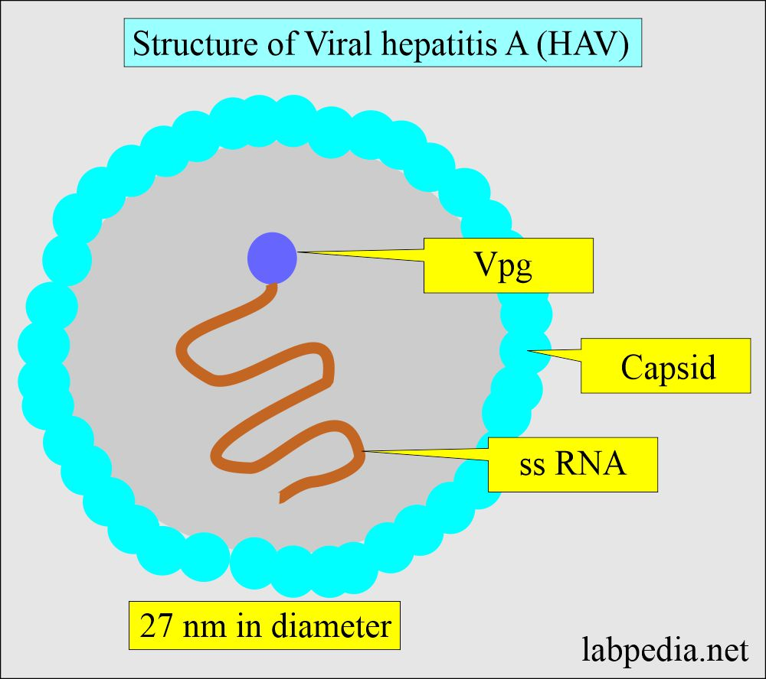
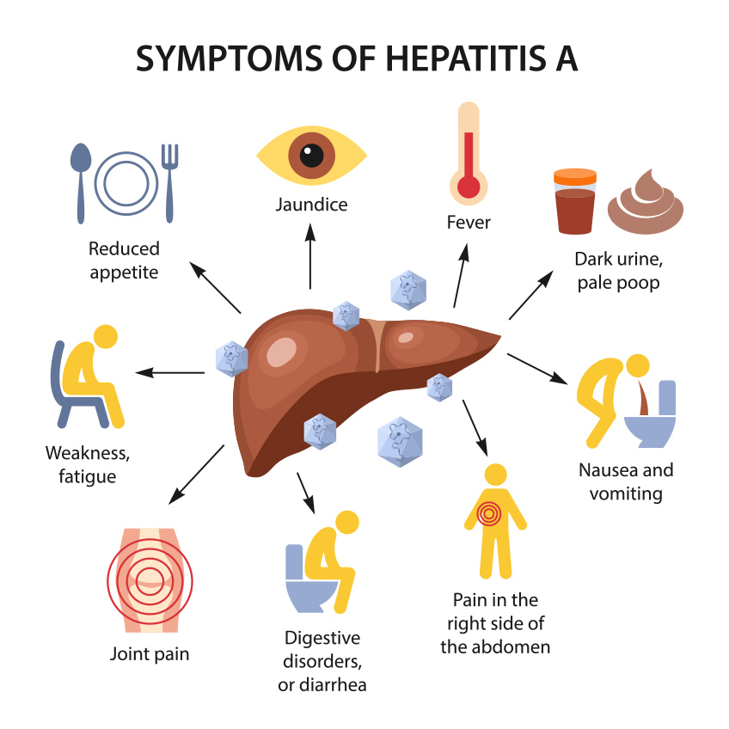
Hepatitis A virus (HAV)
Hepatitis A virus (HAV) is a small, non-enveloped RNA virus.
HAV is primarily transmitted through the fecal-oral route.
Common sources of infection include contaminated food, water, or direct contact with an infected person.
HAV causes acute hepatitis, and the majority of infected individuals recover fully with no chronic infection.

Slide 33
Effective vaccines against HAV are available and are a key preventive measure.
Routine vaccination is recommended, especially in areas with a higher prevalence of the virus.
Recovery from HAV infection provides lifelong immunity.
Passive immunization with immune globulin can provide temporary protection and is sometimes administered to those exposed to the virus.

Slide 34
Diagnostic Tests:
Liver Function Tests: Assess liver health by measuring enzymes such as ALT and AST.
HAV Antibody Testing: Detects antibodies against HAV in the blood.
Detection of IgM Ab indicates recent infection.
Detection of 4-folds rise in IgG Ab diagnose infection.
HAV RNA Testing: polymerase chain reaction (PCR) detects the viral RNA during acute infection.

Slide 35
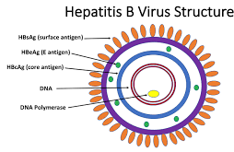
Hepatitis B virus (HBV)
Hepatitis B virus (HBV) is a partially double-stranded DNA virus.
It is a major cause of viral hepatitis and a significant global public health concern.
HBV is primarily transmitted through contact with infected blood and other body fluids.
Common modes of transmission include
sexual contact
perinatal transmission from mother to child
sharing of contaminated needles.

Slide 36
Incubation Period:
  The incubation period for HBV is variable, ranging from 45 to 160 days.
Acute Infection:
  Acute HBV infection can be asymptomatic or present with symptoms such as jaundice, fatigue, abdominal pain, and nausea.
  Most adults clear the virus spontaneously, while infants and young children are more likely to develop chronic infection.
Chronic Infection:
Chronic HBV infection is diagnosed when the virus persists for more than six months.
It can lead to liver inflammation, fibrosis, cirrhosis, and an increased risk of liver cancer.

Slide 37
Diagnostic Tests:
HBsAg Testing: Detects the presence of hepatitis B surface antigen (HBsAg) in the blood, indicating acute or chronic infection.
HBV DNA Testing: polymerase chain reaction (PCR) measures the amount of viral DNA in the blood, helping assess viral replication.
Liver Function Tests: Assess liver health by measuring enzymes such as ALT and AST.

Slide 38
Vaccination:
  Effective vaccines against HBV are available and are a key preventive measure.
  Routine vaccination is recommended, especially for infants, healthcare workers, and individuals at higher risk of exposure.
Maternal-Child Transmission Prevention:
Administering hepatitis B immune globulin (HBIG) and the HBV vaccine to infants born to HBV-positive mothers helps prevent perinatal transmission.

Slide 39
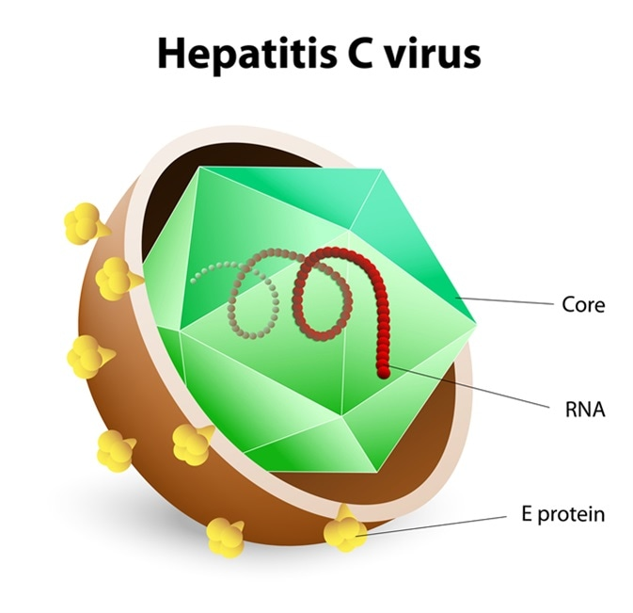
Hepatitis C virus (HCV)
Hepatitis C virus (HCV) is RNA bloodborne pathogen that primarily infects the liver.
It is a major cause of chronic liver disease and can lead to cirrhosis, liver cancer, and liver failure.
Acute HCV infection is often asymptomatic, but some individuals may experience mild flu-like symptoms.
Chronic infection develops in a significant number of cases, increasing the risk of long-term liver damage.

Slide 40
Transmission:
HCV is primarily transmitted through contact with the blood of an infected person.
Common modes of transmission include:
sharing of needles among intravenous drug users,
unsafe medical practices,
through sexual contact
from mother to child during childbirth.

Slide 41
Diagnosis:
1-HCV Antibody Testing:
Purpose: To detect antibodies against HCV in the blood.
Method: enzyme-linked immunosorbent assay (ELISA) or chemiluminescent immunoassay (CIA).
Interpretation: A positive result indicates exposure to HCV.
Further testing is required to confirm active infection.

Slide 42
2-HCV RNA Testing:
Purpose: To confirm active infection by detecting the presence of HCV RNA (genetic material) in the blood.
Method: Polymerase chain reaction (PCR).
Interpretation: A positive result confirms active infection.
The viral load (quantity of HCV RNA) is often measured to assess the severity of infection.

Slide 43
3-Liver Function Tests:
Purpose: To assess the extent of liver damage caused by HCV infection.
Components: Includes tests such as alanine aminotransferase (ALT), aspartate aminotransferase (AST), alkaline phosphatase, and bilirubin.
Interpretation: Elevated liver enzyme levels may indicate liver inflammation and damage.

Slide 44


Slide 45
MCQ

Slide 46
The term used to describe unresponsiveness to self-antigens.
a) Autoimmunity
b) Immunologic tolerance
c) Immune response
d) Anergy

Slide 47
The term used to describe unresponsiveness to self-antigens.
a) Autoimmunity
b) Immunologic tolerance
c) Immune response
d) Anergy

Slide 48
The principal factors in the development of autoimmunity.
a) Allergy and pollution
b) Inheritance of susceptibility genes and environmental triggers
c) Exercise and diet
d) Aging and lifestyle

Slide 49
The principal factors in the development of autoimmunity.
a) Allergy and pollution
b) Inheritance of susceptibility genes and environmental triggers
c) Exercise and diet
d) Aging and lifestyle

Slide 50
What is the role of regulatory T cells (Tregs) in peripheral tolerance?
a) Activating other immune cells
b) Suppressing the activity of other immune cells
c) Enhancing the response to self-antigens
d) Causing autoimmune diseases

Slide 51
What is the role of regulatory T cells (Tregs) in peripheral tolerance?
a) Activating other immune cells
b) Suppressing the activity of other immune cells
c) Enhancing the response to self-antigens
d) Causing autoimmune diseases

Slide 52
Where does central tolerance occur in the maturation of immune cells?
a) Peripheral tissues
b) Thymus and bone marrow
c) Spleen
d) Lymph nodes

Slide 53
Where does central tolerance occur in the maturation of immune cells?
a) Peripheral tissues
b) Thymus and bone marrow
c) Spleen
d) Lymph nodes

Slide 54
What type of diabetes is associated with autoimmune destruction of insulin-producing cells?
a) Type 2 diabetes
b) Gestational diabetes
c) Diabetes mellitus type 1 (IDDM)
d) Diabetes Insipidus

Slide 55
What type of diabetes is associated with autoimmune destruction of insulin-producing cells?
a) Type 2 diabetes
b) Gestational diabetes
c) Diabetes mellitus type 1 (IDDM)
d) Diabetes Insipidus

Slide 56
The main target of Human Immunodeficiency Virus (HIV) during infection?
a) Red blood cells
b) B cells
c) CD4+ T cells
d) Natural killer cells

Slide 57
The main target of Human Immunodeficiency Virus (HIV) during infection?
a) Red blood cells
b) B cells
c) CD4+ T cells
d) Natural killer cells

Slide 58
The incubation period for Hepatitis B virus (HBV)
a) 14 days
b) 30 days
c) 60 days
d) From 45 to 160 days

Slide 59
The incubation period for Hepatitis B virus (HBV)
a) 14 days
b) 30 days
c) 60 days
d) From 45 to 160 days

Slide 60
Detection of IgM antibodies against HAV indicate.
a) Past infection
b) Chronic infection
c) Recent infection
d) Immunity

Slide 61
Detection of IgM antibodies against HAV indicate.
a) Past infection
b) Chronic infection
c) Recent infection
d) Immunity

Slide 62
Which population group is especially recommended for routine Hepatitis B vaccination?
a) Elderly individuals
b) Pregnant women
c) Infants, healthcare workers, and individuals at higher risk of exposure
d) Individuals with a history of antibiotic use

Slide 63
Which population group is especially recommended for routine Hepatitis B vaccination?
a) Elderly individuals
b) Pregnant women
c) Infants, healthcare workers, and individuals at higher risk of exposure
d) Individuals with a history of antibiotic use

